Slide 1


TELCO CHURN PREDICTION
BUAN 6356 FALL 2022
GROUP 9
Moksh Mehool Mehta
Spandana Aelapati
Rithwik Reddy
Koti Reddy
John Hart

Slide 2


TABLE OF CONTENTS
Abstract
Introduction
Data Description
Exploratory Data Analysis
BI Model
Conclusion
Future Enhancements

Slide 3
ABSTRACT
Customer churn analysis and prediction in telecom sector is an issue now a days because it’s very important for telecommunication industries to analyze behaviors of various customer to predict which customers are about to leave their subscription. So machine learning techniques and algorithm plays an important role for companies in today’s commercial conditions because gaining a new customer’s cost is more than retaining the existing ones. This project focuses on various machine learning techniques for predicting customer churn through which we can build and compare the classification models such as Logistic Regression, Random Forest and lazy learning.

Slide 4
INTRODUCTION
Churners are customers that discontinue using a product or service for a predetermined amount of time. The person who has chosen to no longer use a company's services is known as a churn in a telecommunications company. The churn model identifies people who is most likely going to leave the company soon.
A frequent application for data mining is to create models that resemble churns in several businesses. Everywhere you look, there are mobile phone companies who are almost ready to create their own churn model.
Furthermore, churn results can be effectively used for a variety of other objectives in addition to customer retention. The first step in creating a model is actually to use a churn management method. Instead of choosing a single approach that has the best lift, the project generally needs a churn model in the best way. So, as a long-term standard, we have created an automated application.
The customer of one business could also be a customer of one or more telecommunications companies in this digital age. Some of us might use various carriers depending on the distance, while others would do so depending on the various plans each carrier offers.

Slide 5

DATA DESCRIPTION
Our main variables focused on were Senior Citizens, Monthly Charges, Tenure
It was very important for us to see if the Churn rate on each of these are statistically significant
Other variables included: Payment Method, Contract, Dependents
The data was separated into both a training and testing dataset

Slide 6
PACKAGES USED
ggplot2
pROC
Latice
plyr
Caret
These packages were necessary to run analytical and visual reports on the data

Slide 7
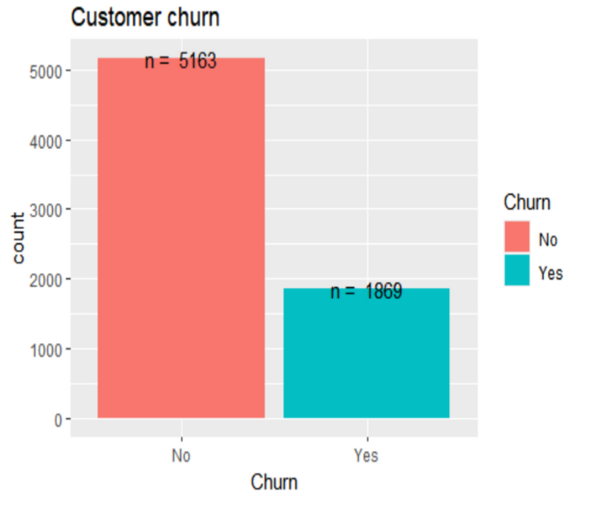
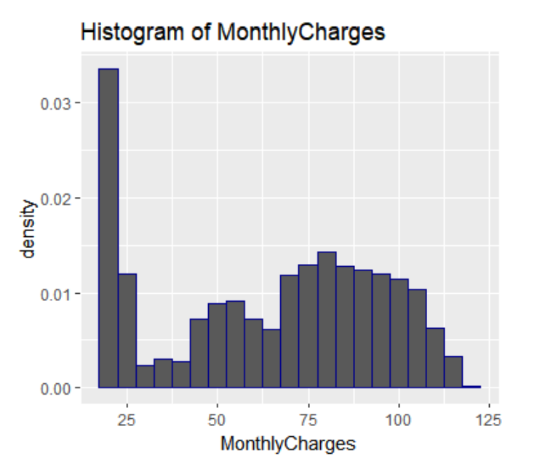
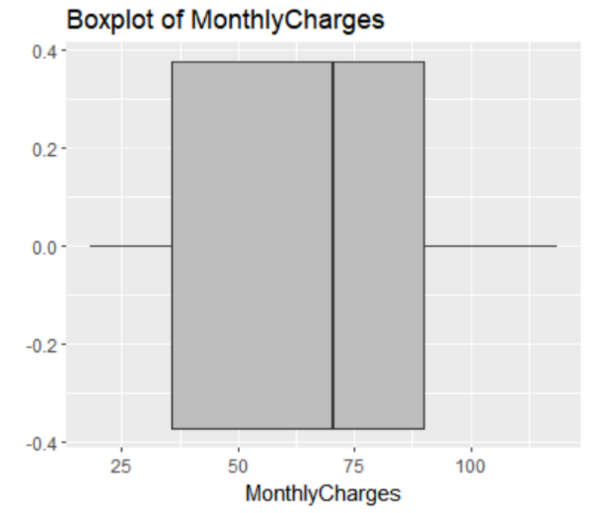
EXPLORATORY DATA ANALYSIS
NUMBER OF CUSTOMERS WHO LEFT IN THE LAST MONTH
DISTRIBUTION OF MONTHLY CHARGES
BOXPLOT OF MONTHLY CHARGES

Slide 8
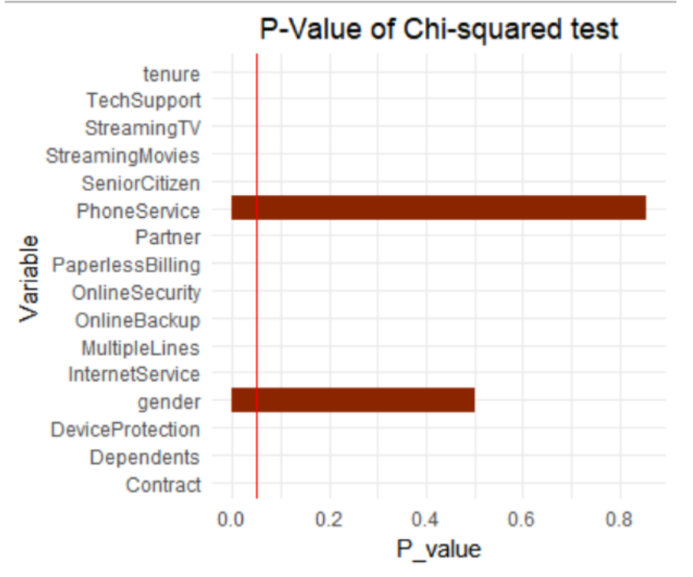
FEATURE SELECTION
Feature selection is an important step in the process of building a predictive model, and it is particularly relevant in the context of business intelligence
It helps in improving the performance of a predictive model and also helps in reducing overall complexity
We used the chi-square test to evaluate the relationship between each feature and the response variable, and to select only the features that have a significant relationship with the response variable.
This in turn improved the interpretability of the models by removing irrelevant and redundant features.

Slide 9

BI MODEL
Using the sample() method, divide the data into training data (80%) and testing data (20%)).
A machine learning model is trained using the train() function.
Utilizing the trainControl() function to manage the train() method's computation. The repeated sampling technique is cv.
Models - Logistic Regression, Random Forest, & KNN.

Slide 10
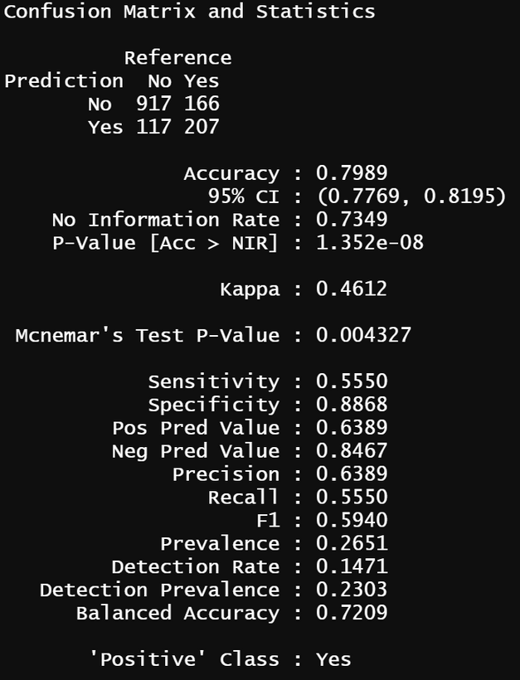
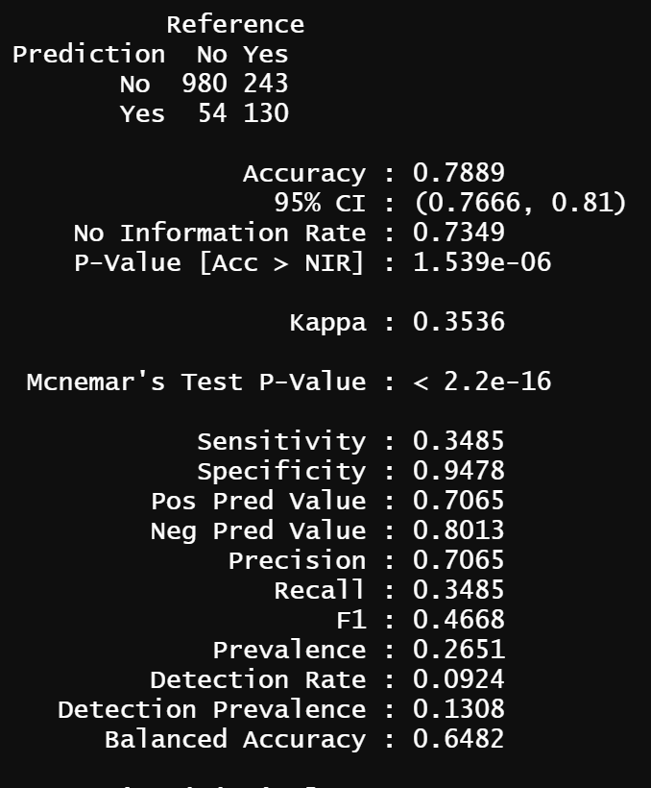
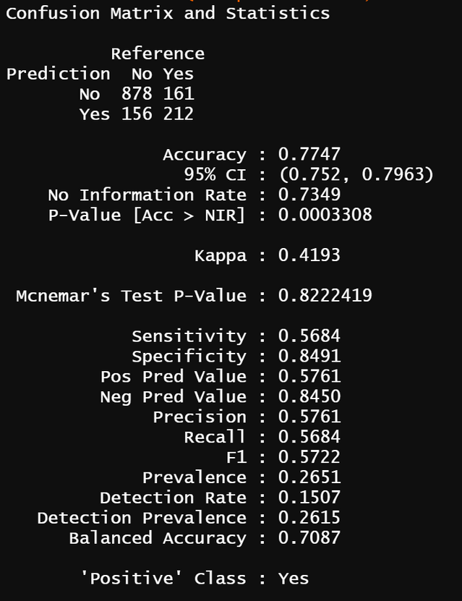
COMPARISON OF THE MODELS
Logistic Regression Random Forest KNN

Slide 11
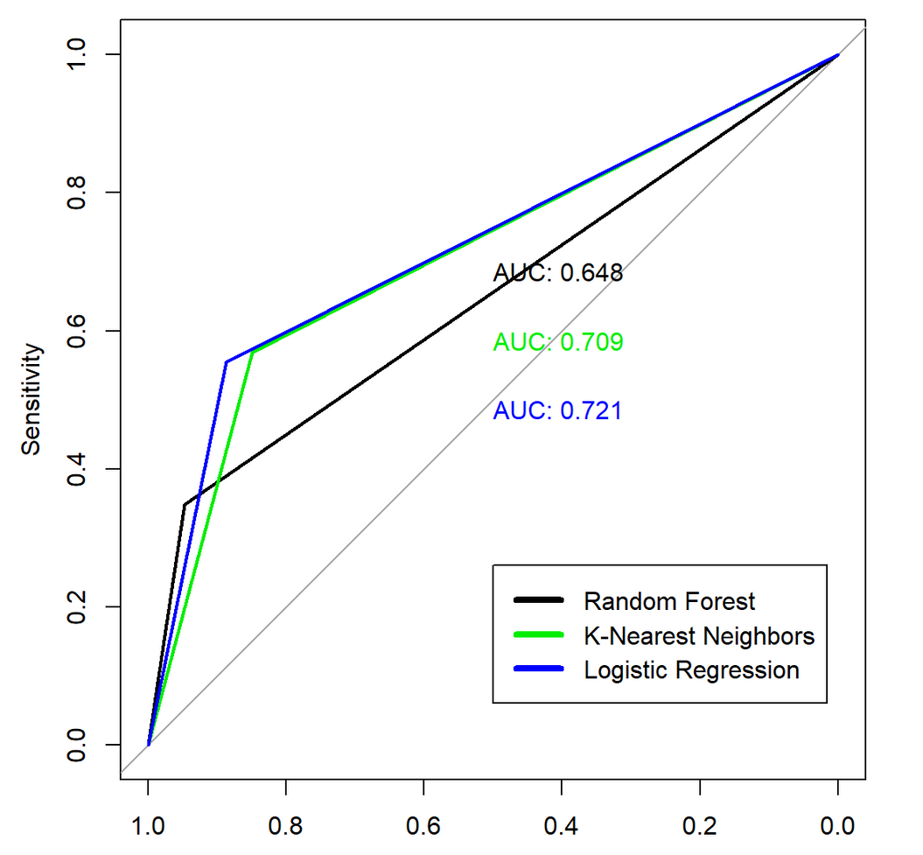
MODEL EVALUATION
The AUC is a measure of how well the various groups of values can be distinguished, whereas the ROC curve is a representation of the probability curve of the data when it is plotted using the plot.roc() function.
The greatest AUC value was for Logistic Regression (AUC = 0.721)

Slide 12
CONCLUSION
The importance of this type of research in the telecom market is to help companies make more profit.Telecom companies may see things clearly and provide customers tempting incentives to continue using their services.
The findings gained demonstrate that our suggested churn model performed better and delivered better results when applying machine learning techniques.

Slide 13
FUTURE ENHANCEMENT
In the near future, more columns can be eliminated in order to improve interpretability
Additional machine learning models can be included to further improve performance like neural networks and deep learning.
There are several ways to improve logistic regression, including using regularization to prevent overfitting, using more advanced optimization algorithms, and using nonlinear transformations of the input features. Additionally, using ensembles of multiple logistic regression models can often improve performance.

Slide 14
REFERENCES
1. Abhishek and Ratnesh ,“Predicting Customer Churn Prediction in Telecom Sector Using Various Machine Learning Techniques”, In the proceedings of 2017 International Conference on Advanced Computation and Telecommunication, Bhopal, India, 2017.
2. Abinash and Srinivasulu U ,“Machine Learning techniques applied to prepaid subscribers: case study on the telecom industry of Morocco”, In the proceedings of 2017 International Conference on Inventive Computing and Informatics , Coimbatore, India, pp. 721-725, 2017.
3. Trupti S. Gaikwad; Snehal A. Jadhav; Ruta R. Vaidya; Snehal H. Kulkarni. "Machine learning amalgamation of Mathematics, Statistics and Electronics". International Research Journal on Advanced Science Hub, 2, 7, 2020, 100-108. doi: 10.47392/irjash.2020.72
4. Alae and El Hassane , “A Comparative Study of Customer Churn Prediction in Telecom Industry Using Ensemble Based Classifiers”, In the proceedings of Intelligent Systems and Computer Vision , Fez, Morocco, 2017.
5. Salini Suresh; Suneetha V; Niharika Sinha; Sabyasachi Prusty; Sriranga H.A. "Machine Learning: An Intuitive Approach In Healthcare". International Research Journal on Advanced Science Hub, 2, 7, 2020, 67-74. doi: 10.47392/irjash.2020.67

Slide 15

THANK YOU

